Slide 1
Guide to Computer Forensics and Investigations
Fourth Edition
Chapter 7
Current Computer Forensics Tools
Last modified 10-4-10 11:40 am

Slide 2
Objectives
Explain how to evaluate needs for computer forensics tools
Describe available computer forensics software tools
List some considerations for computer forensics hardware tools
Describe methods for validating and testing computer forensics tools

Slide 3
Evaluating Computer Forensics Tool Needs

Slide 4
Evaluating Computer Forensics Tool Needs
Look for versatility, flexibility, and robustness
  OS
  File system(s)
  Script capabilities
  Automated features
  Vendor’s reputation for support
Keep in mind what application files you will be analyzing

Slide 5
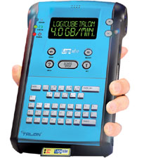
Types of Computer Forensics Tools
Hardware forensic tools
  Range from single-purpose
  components to complete computer
  systems and servers
Software forensic tools
  Types
    Command-line applications
    GUI applications
  Commonly used to copy data from a suspect’s disk drive to an image file
Logicube Talon (link Ch 7a)

Slide 6
Tasks Performed by Computer Forensics Tools
Five major categories:
  Acquisition
  Validation and discrimination
  Extraction
  Reconstruction
  Reporting

Slide 7
Acquisition
Making a copy of the original drive
Acquisition subfunctions:
  Physical data copy
  Logical data copy
  Data acquisition format
  Command-line acquisition
  GUI acquisition
  Remote acquisition
  Verification

Slide 8
Acquisition (continued)
Two types of data-copying methods are used in software acquisitions:
  Physical copying of the entire drive
  Logical copying of a disk partition
The formats for disk acquisitions vary
  From raw data to vendor-specific proprietary compressed data
You can view the contents of a raw image file with any hexadecimal editor

Slide 9
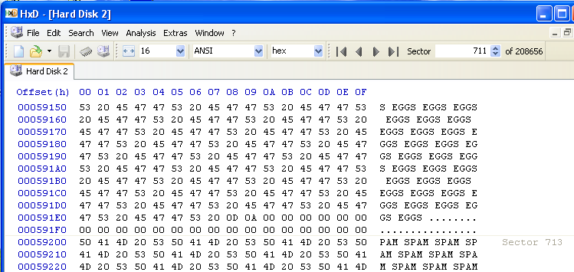

Slide 10
Acquisition (continued)
Creating smaller segmented files is a typical feature in vendor acquisition tools
All computer forensics acquisition tools have a method for verification of the data-copying process
  That compares the original drive with the image

Slide 11
Validation and discrimination
Validation
  Ensuring the integrity of data being copied
Discrimination of data
  Involves sorting and searching through all investigation data

Slide 12
Validation and discrimination (continued)
Subfunctions
  Hashing
    CRC-32, MD5, Secure Hash Algorithms
  Filtering
    Known system files can be ignored
    Based on hash value sets
  Analyzing file headers
    Discriminate files based on their types
National Software Reference Library (NSRL) has compiled a list of known file hashes
  For a variety of OSs, applications, and images

Slide 13
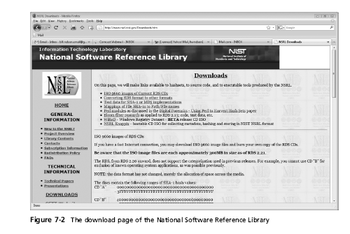
Tasks Performed by Computer Forensics Tools (continued)

Slide 14
Validation and discrimination (continued)
Many computer forensics programs include a list of common header values
  With this information, you can see whether a file extension is incorrect for the file type
Most forensics tools can identify header values

Slide 15
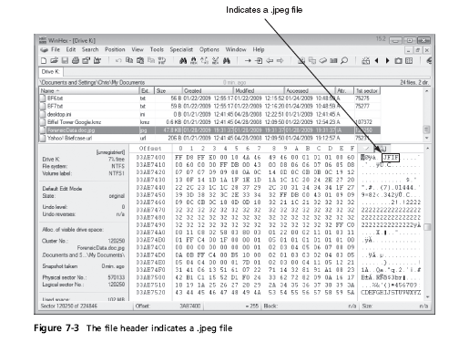

Slide 16
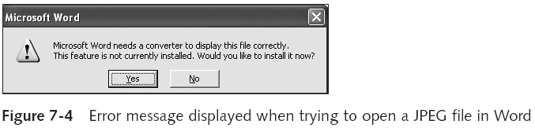
Tasks Performed by Computer Forensics Tools (continued)

Slide 17
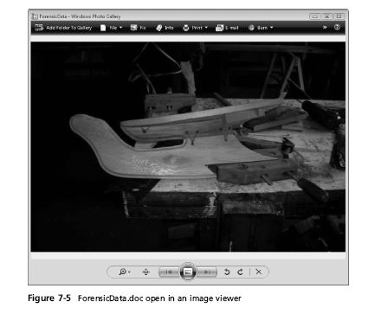

Slide 18
Extraction
Recovery task in a computing investigation
Most demanding of all tasks to master
Recovering data is the first step in analyzing an investigation’s data

Slide 19
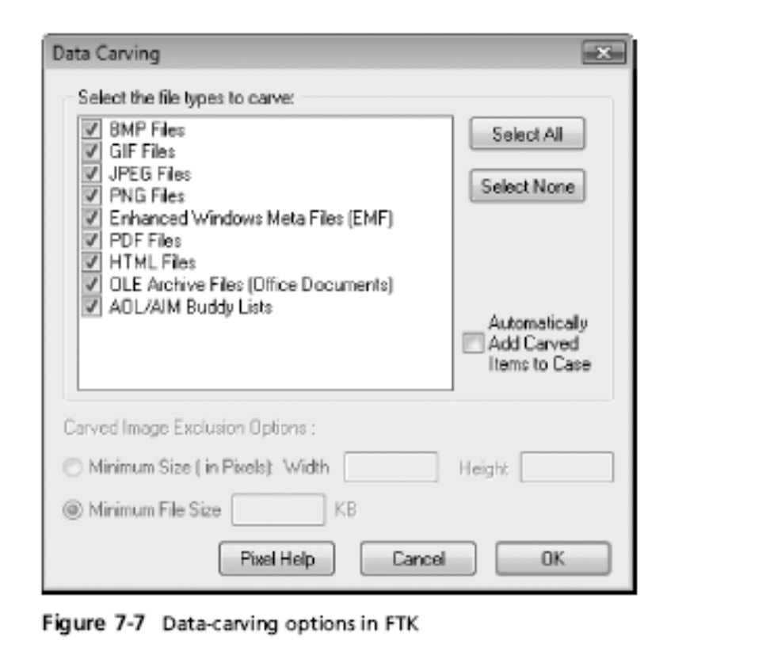
Extraction (continued)
Subfunctions
  Data viewing
  Keyword searching
  Decompressing
  Carving (reconstructing
  file fragments)
  Decrypting
  Bookmarking
Keyword search speeds up analysis for investigators

Slide 20
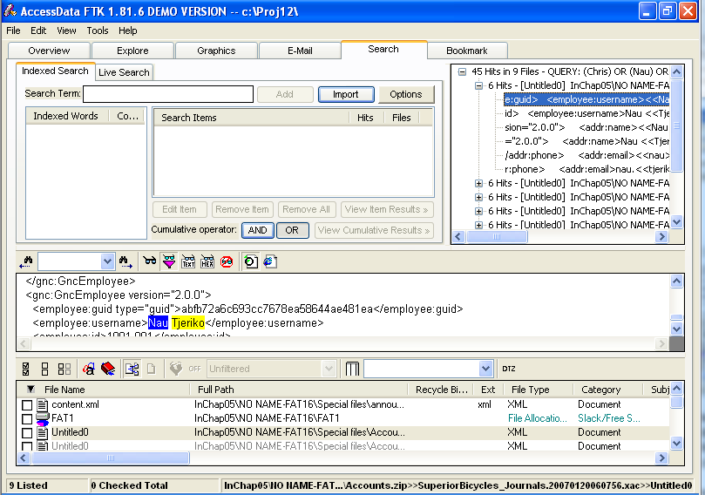
FTK's Search Pane

Slide 21
Extraction (continued)
From an investigation perspective, encrypted files and systems are a problem
Many password recovery tools have a feature for generating potential password lists
  For a password dictionary attack
If a password dictionary attack fails, you can run a brute-force attack

Slide 22
Reconstruction
Re-create a suspect drive to show what happened during a crime or an incident
Subfunctions
  Disk-to-disk copy
  Image-to-disk copy
  Partition-to-partition copy
  Image-to-partition copy
This is easiest if a matching blank hard disk is available, same make and model

Slide 23
Reconstruction (continued)
Some tools that perform an image-to-disk copy:
  SafeBack
  SnapBack
  EnCase
  FTK Imager
  ProDiscover

Slide 24
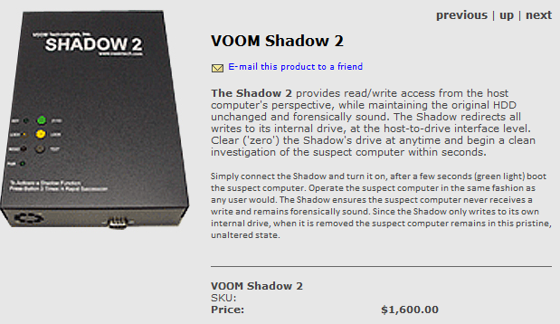
VOOM Shadow 2
For write-blocked courtroom demos using real original drive, use Voom Shadow 2 (link Ch 7b)

Slide 25
Reporting
To complete a forensics disk analysis and examination, you need to create a report
Subfunctions
  Log reports
  Report generator
Use this information when producing a final report for your investigation

Slide 26
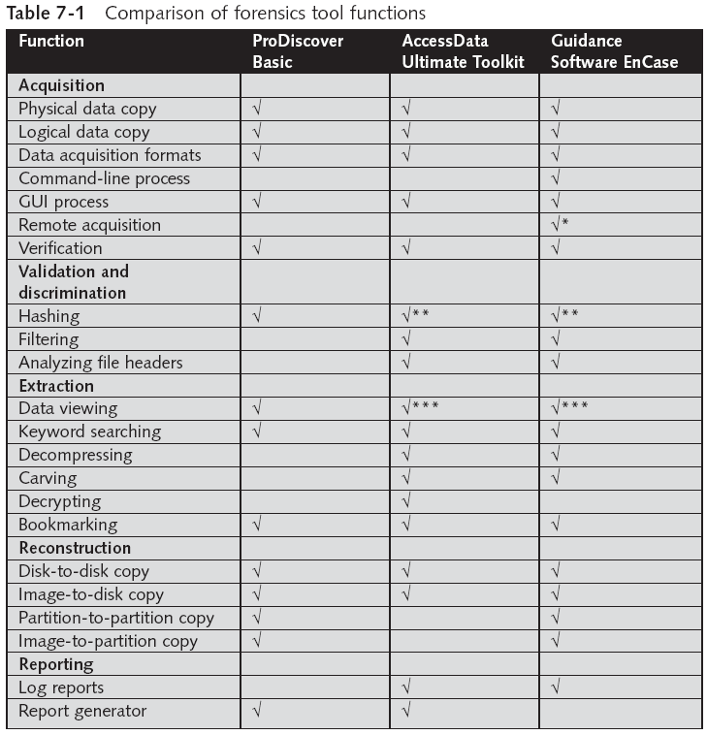
Tool Comparisons

Slide 27
Other Considerations for Tools
Considerations
  Flexibility
  Reliability
  Expandability
  Keep a library with older version of your tools
Create a software library containing older versions of forensics utilities, OSs, and other programs

Slide 28
Computer Forensics Software Tools

Slide 29
Computer Forensics Software Tools
The following sections explore some options for command-line and GUI tools in both Windows and UNIX/Linux

Slide 30
Command-line Forensic Tools
The first tools that analyzed and extracted data from floppy disks and hard disks were MS-DOS tools for IBM PC file systems
Norton DiskEdit
  One of the first MS-DOS tools used for computer investigations
Advantage
  Command-line tools require few system resources
    Designed to run in minimal configurations

Slide 31
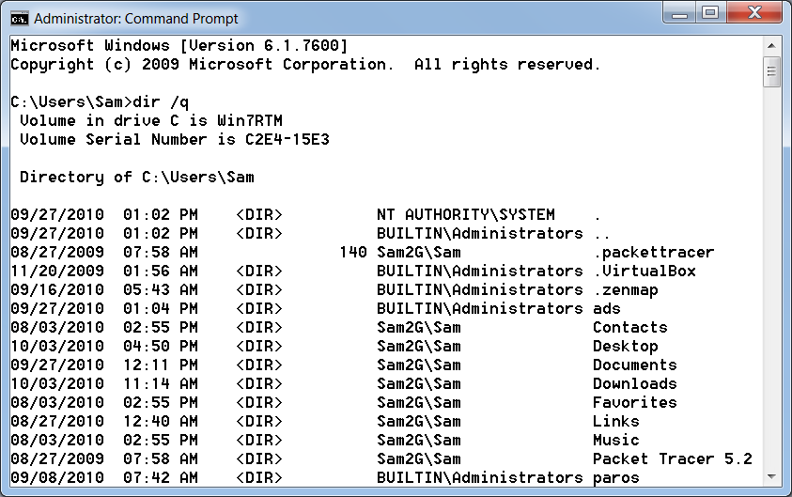
DIR /Q
Shows file owner

Slide 32
UNIX/Linux Forensic Tools
*nix platforms have long been the primary command-line OSs
SMART
  Designed to be installed on numerous Linux versions
  Can analyze a variety of file systems with SMART
  Many plug-in utilities are included with SMART
  Another useful option in SMART is its hex viewer
  Link Ch 7d

Slide 33
UNIX/Linux Forensic Tools (continued)
Helix
  One of the easiest suites to begin with
  You can load it on a live Windows system
    Loads as a bootable Linux OS from a cold boot
Autopsy and SleuthKit
  Sleuth Kit is a Linux forensics tool
  Autopsy is the GUI/browser interface used to access Sleuth Kit’s tools

Slide 34
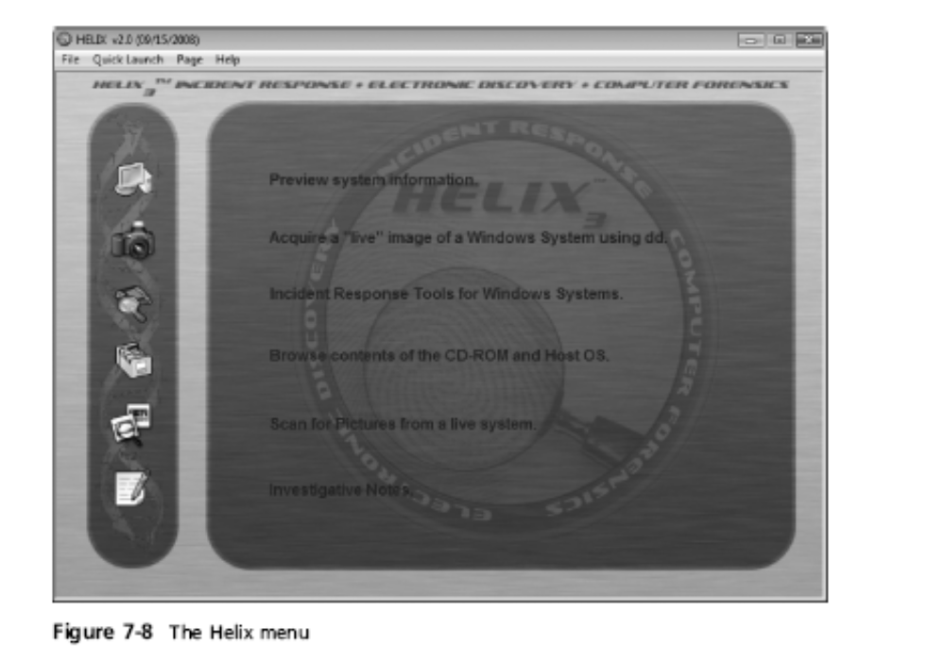

Slide 35
UNIX/Linux Forensic Tools (continued)
Knoppix-STD
  Knoppix Security Tools Distribution (STD)
    A collection of tools for configuring security measures, including computer and network forensics
  Knoppix-STD is forensically sound
    Doesn’t allow you to alter or damage the system you’re analyzing
  Knoppix-STD is a Linux bootable CD

Slide 36
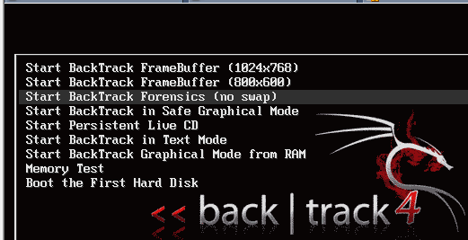
BackTrack
BackTrack 4 has a Forensics Mode
But it’s not the default boot mode, so you need to be careful

Slide 37
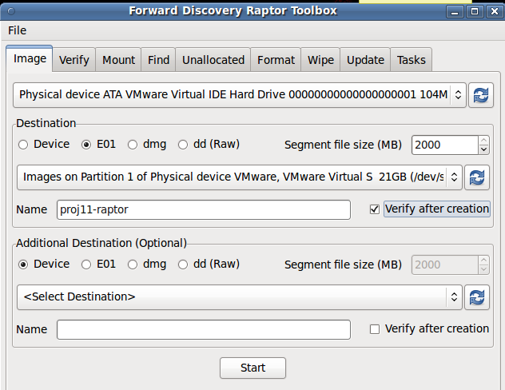
Raptor
Forensic LiveCD (link Ch 7e)

Slide 38
Other GUI Forensic Tools
Simplify computer forensics investigations
Help training beginning investigators
Most of them come into suites of tools
Advantages
  Ease of use
  Multitasking
  No need for learning older OSs

Slide 39
Other GUI Forensic Tools (continued)
Disadvantages
  Excessive resource requirements
  Produce inconsistent results
  Create tool dependencies

Slide 40
Computer Forensics Hardware Tools

Slide 41
Computer Forensics Hardware Tools
Technology changes rapidly
Hardware eventually fails
  Schedule equipment replacements
When planning your budget consider:
  Failures
  Consultant and vendor fees
  Anticipate equipment replacement

Slide 42
Forensic Workstations
Carefully consider what you need
Categories
  Stationary
  Portable
  Lightweight
Balance what you need and what your system can handle

Slide 43
Forensic Workstations (continued)
Police agency labs
  Need many options
  Use several PC configurations
Private corporation labs
  Handle only system types used in the organization
Keep a hardware library in addition to your software library

Slide 44
Building your Own Forensic Workstation
Not as difficult as it sounds
Advantages
  Customized to your needs
  Save money
Disadvantages
  Hard to find support for problems
  Can become expensive if careless
Also need to identify what you intend to analyze

Slide 45
Purchasing a Forensic Workstation
You can buy one from a vendor as an alternative
Examples
  F.R.E.D.
  F.I.R.E. IDE
Having vendor support can save you time and frustration when you have problems
Can mix and match components to get the capabilities you need for your forensic workstation

Slide 46
Using a Write-Blocker
Write-blocker
  Prevents data writes to a hard disk
Software-enabled blockers
  Software write-blockers are OS dependant
  Example: PDBlock from Digital Intelligence
    DOS only, not Windows (link Ch 6f)
Hardware options
  Ideal for GUI forensic tools
  Act as a bridge between the suspect drive and the forensic workstation

Slide 47
Using a Write-Blocker (continued)
Can navigate to the blocked drive with any application
Discards the written data
  For the OS the data copy is successful
Connecting technologies
  FireWire
  USB 2.0
  SCSI controllers

Slide 48
Recommendations for a Forensic Workstation
Determine where data acquisitions will take place
Data acquisition techniques
  USB 2.0
  FireWire
Expansion devices requirements
Power supply with battery backup
Extra power and data cables

Slide 49
Recommendations for a Forensic Workstation (continued)
External FireWire and USB 2.0 ports
Assortment of drive adapter bridges
Ergonomic considerations
  Keyboard and mouse
  A good video card with at least a 17-inch monitor
High-end video card and monitor
If you have a limited budget, one option for outfitting your lab is to use high-end game PCs

Slide 50
Validating and Testing Forensic Software

Slide 51
Validating and Testing Forensic Software
Make sure the evidence you recover and analyze can be admitted in court
Test and validate your software to prevent damaging the evidence

Slide 52
Using National Institute of Standards and Technology (NIST) Tools
Computer Forensics Tool Testing (CFTT) program
  Manages research on computer forensics tools
NIST has created criteria for testing computer forensics tools based on:
  Standard testing methods
  ISO 17025 criteria for testing items that have no current standards
  ISO 5725

Slide 53
Using National Institute of Standards and Technology (NIST) Tools (continued)
Your lab must meet the following criteria
  Establish categories for computer forensics tools
  Identify computer forensics category requirements
  Develop test assertions
  Identify test cases
  Establish a test method
  Report test results
Also evaluates drive-imaging tools
  See link Ch 7g

Slide 54
Using National Institute of Standards and Technology (NIST) Tools (continued)
National Software Reference Library (NSRL) project
  Collects all known hash values for commercial software applications and OS files
    Uses SHA-1 to generate a known set of digital signatures called the Reference Data Set (RDS)
  Helps filtering known information
  Can use RDS to locate and identify known bad files

Slide 55
Using Validation Protocols
Always verify your results
Use at least two tools
  Retrieving and examination
  Verification
Understand how tools work
One way to compare results and verify a new tool is by using a disk editor
  Such as Hex Workshop or WinHex
  But it won't work with encrypted or compressed files

Slide 56
Using Validation Protocols (continued)
Disk editors
  Do not have a flashy interface
  Reliable tools
  Can access raw data
Computer Forensics Examination Protocol
  Perform the investigation with a GUI tool
    Usually FTK or EnCase
  Verify your results with a disk editor
  If a file is recovered, compare hash values obtained with both tools

Slide 57
Using Validation Protocols (continued)
Computer Forensics Tool Upgrade Protocol
  Test
    New releases
    OS patches and upgrades
  If you find a problem, report it to forensics tool vendor
    Do not use the forensics tool until the problem has been fixed
  Use a test hard disk for validation purposes
  Check the Web for new editions, updates, patches, and validation tests for your tools

